Slide 1
Electronic Mail Security S/MIME
Module 7

Slide 2
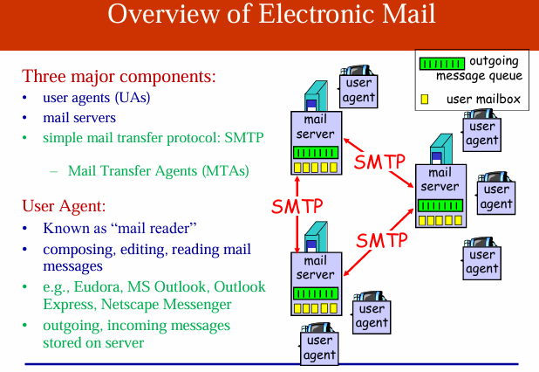

Slide 3
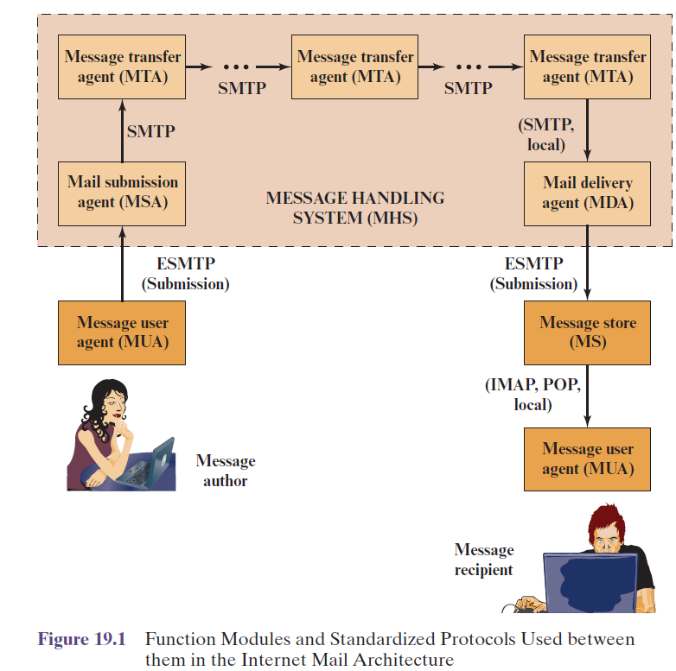
Email Components

Slide 4
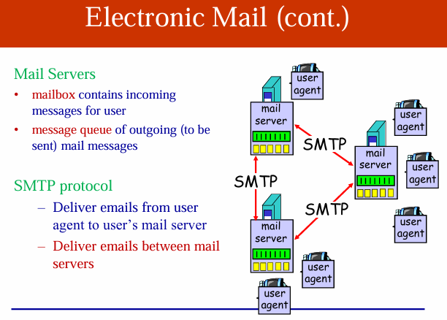

Slide 5
Simple Mail Transfer Protocol
SMTP encapsulates an email message in an envelope
The operation of SMTP consists of a series of commands and responses exchanged between the SMTP sender and receiver.
The initiative is with the SMTP sender, who establishes the TCP connection.
Once the connection is established, the SMTP sender sends commands over the connection to the receiver.
Each command consists of a single line of text, beginning with a four-letter command code followed in some cases by an argument field.
Each command generates exactly one reply from the SMTP receiver

Slide 6
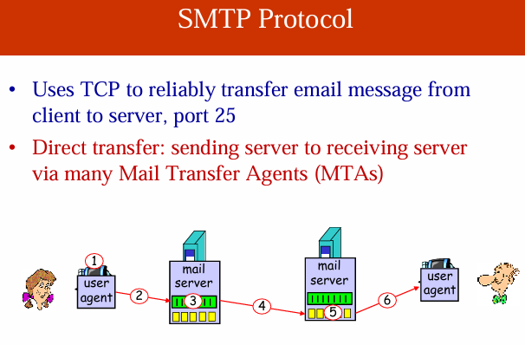

Slide 7
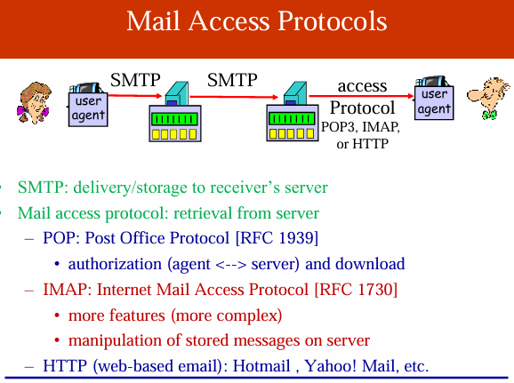

Slide 8
Mail Access Protocols (POP 3, IMAP )
Post Office Protocol (POP3) allows an email client (user agent) to download an email from an email server (MTA).
POP3 user agents connect via TCP to the server (typically port 110).
IMAP also uses TCP, with server TCP port 143.
IMAP is more complex than POP3.
IMAP provides stronger authentication than POP3 and provides other functions not supported by POP3.

Slide 9
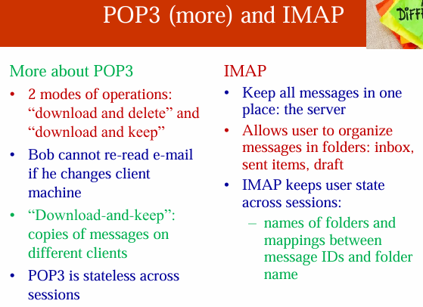

Slide 10
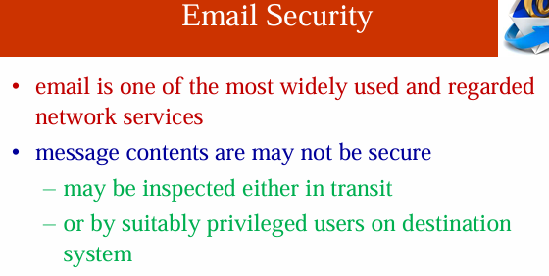

Slide 11
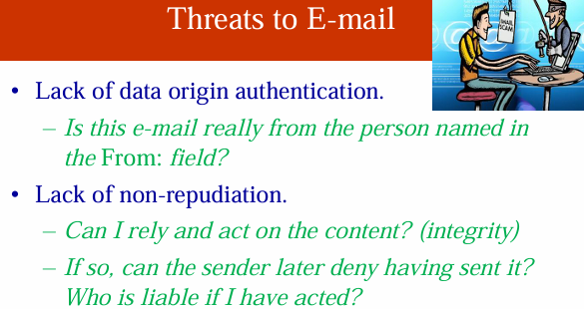
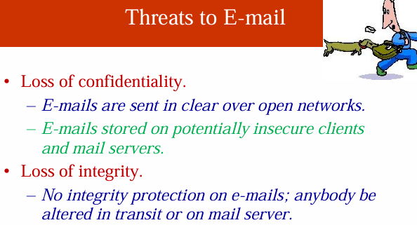
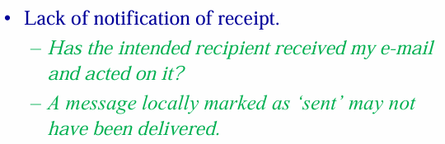

Slide 12
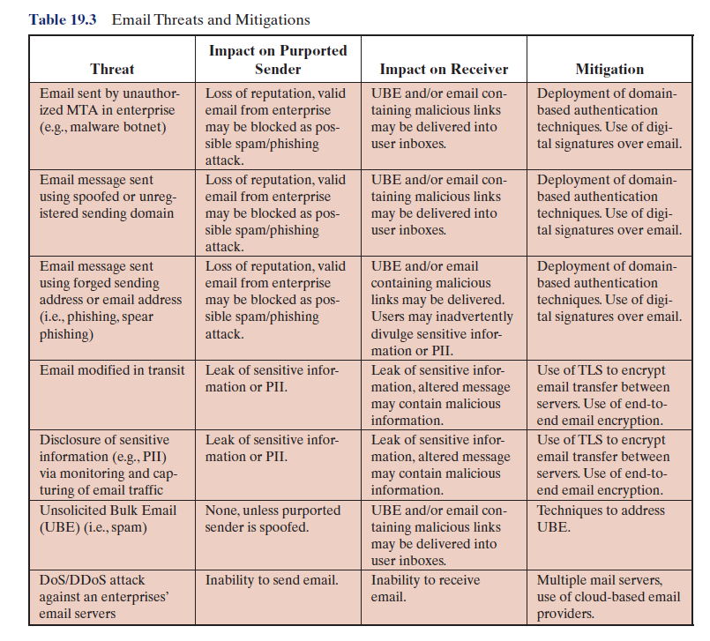
Email Threats

Slide 13
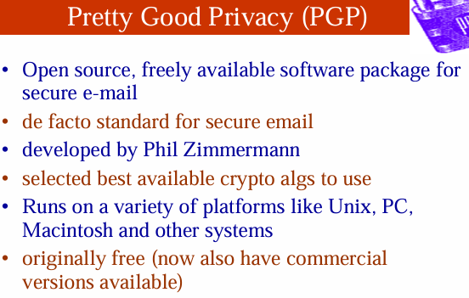

Slide 14
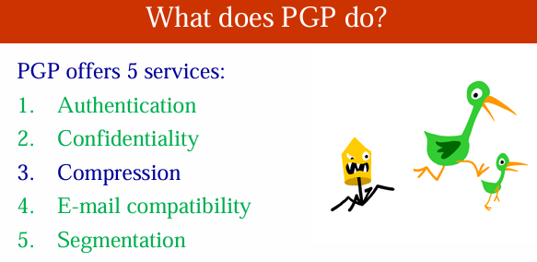

Slide 15
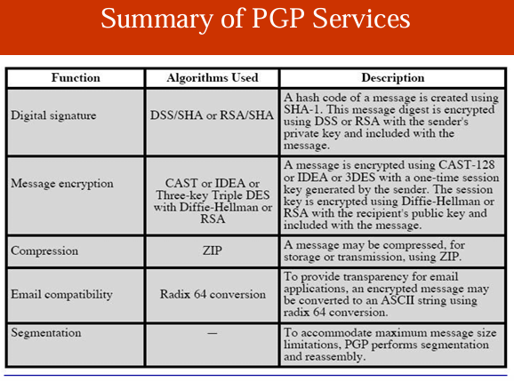

Slide 16
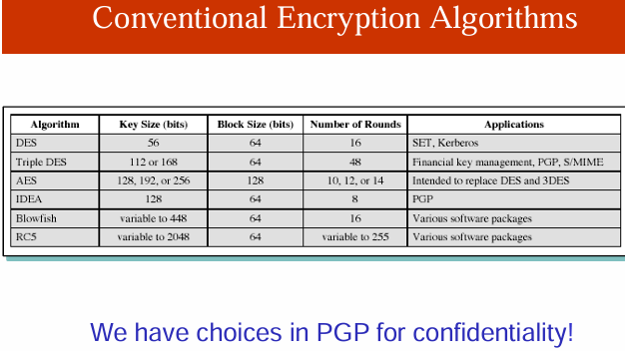

Slide 17
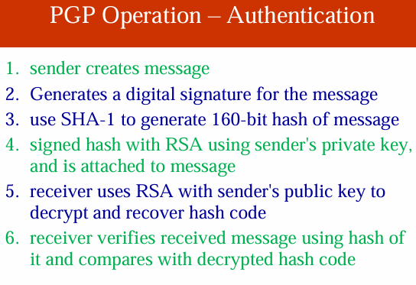
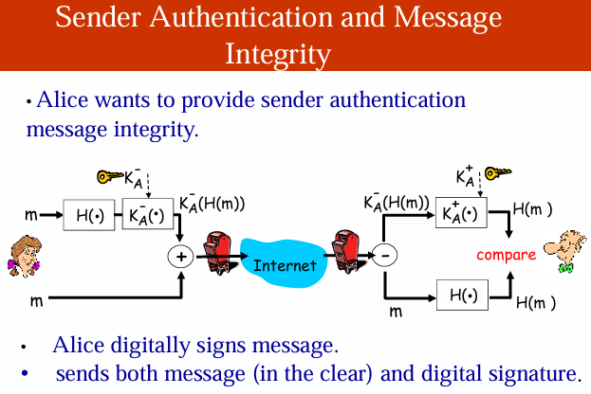

Slide 18
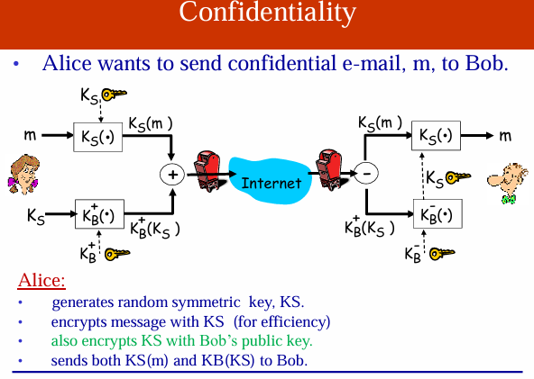
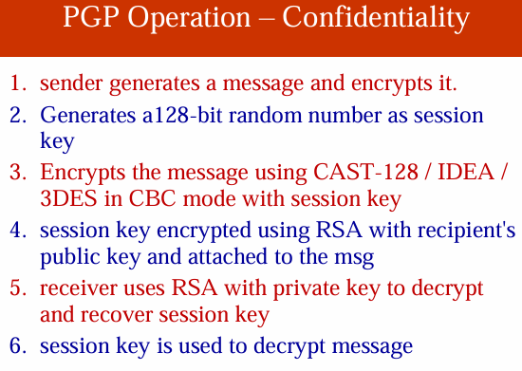
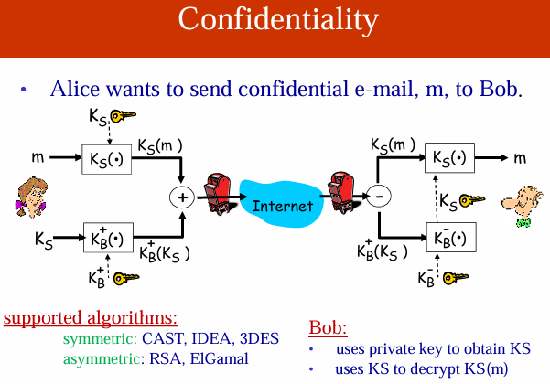

Slide 19
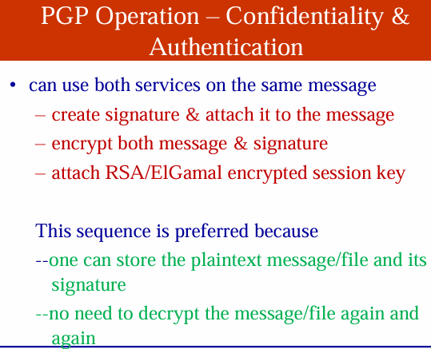
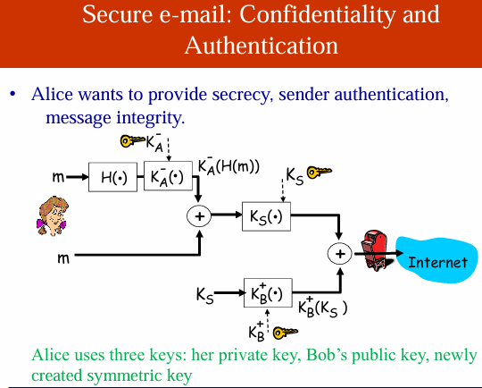

Slide 20
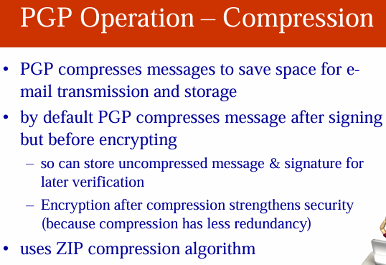
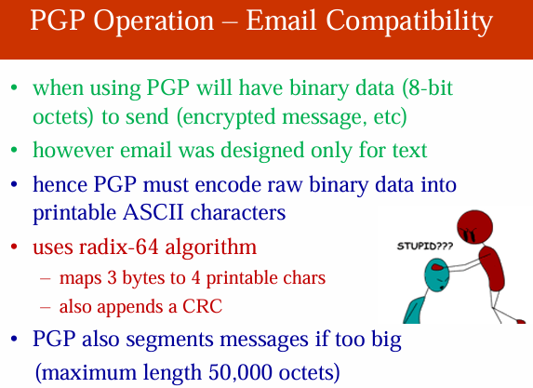

Slide 21
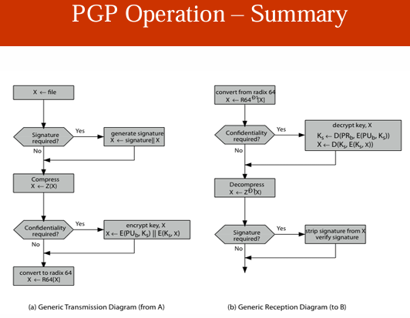

Slide 22
S/MIME
Secure/Multipurpose Internet Mail Extension (S/MIME) is a security enhancement to the MIME Internet email format standard based on technology from RSA Data Security.
A standard way for email encryption and signing
Industry support
Not a standalone software, a system that is to be supported by email clients – such as MS Outlook and Thunderbird
S/MIME handles digital signatures – Also provides encryption
S/MIME provides for four message-related services:
authentication
confidentiality
compression
email compatibility

Slide 23
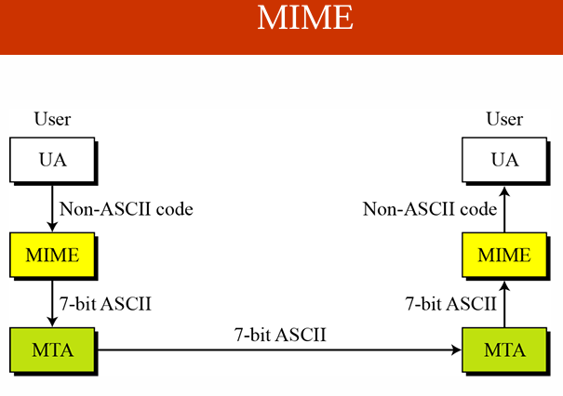
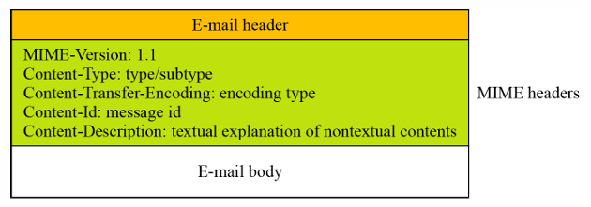
MIME Headers

Slide 24
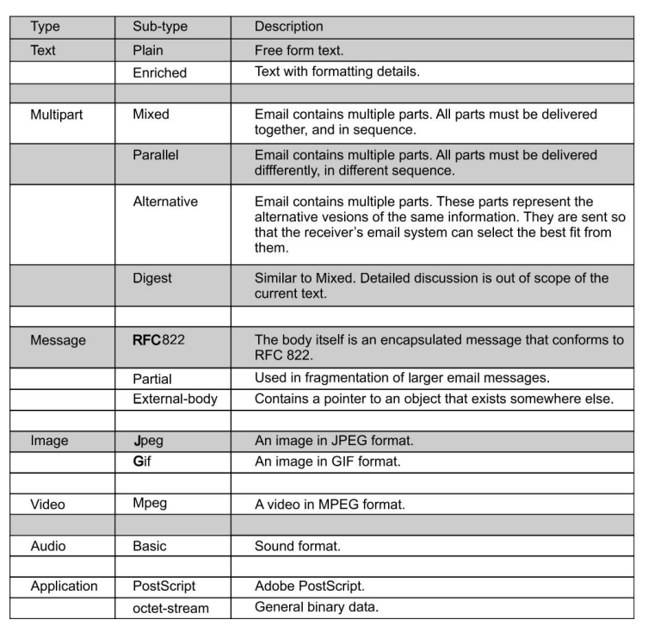
MIME Data Types

Slide 25
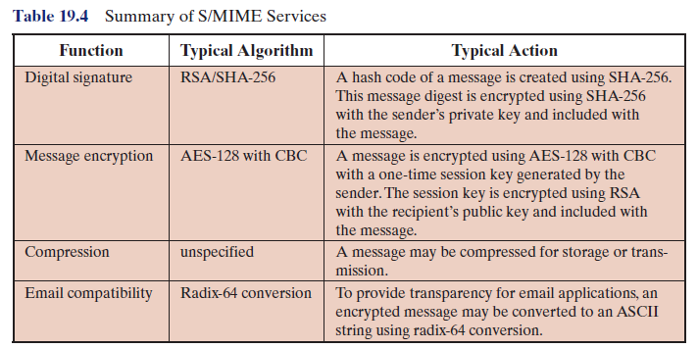
S/MIME Services

Slide 26
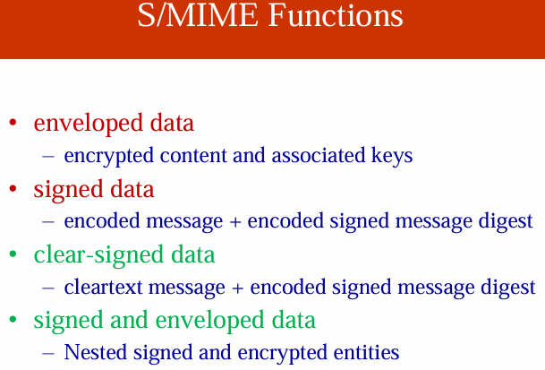

Slide 27
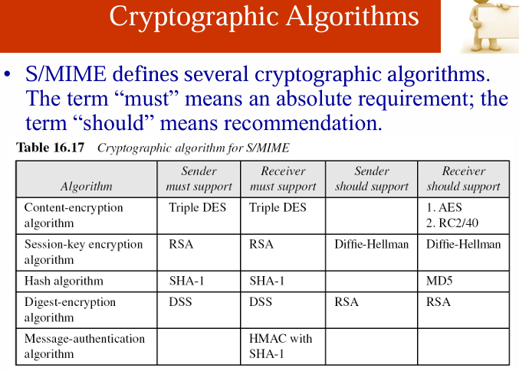

Slide 28
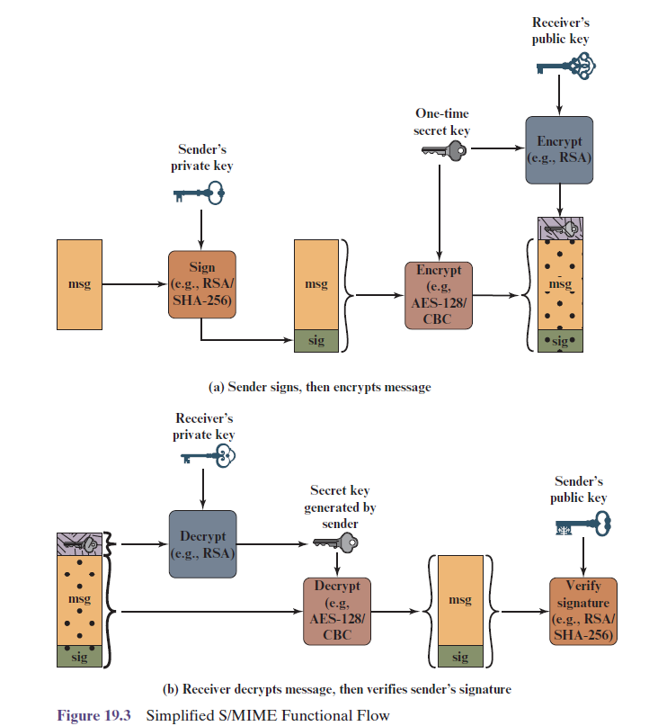

Slide 29
Securing a MIME Entity
S/MIME secures a MIME entity with a signature, encryption, or both.
A MIME entity may be an entire message
The MIME entity plus some security-related data, such as algorithm identifiers and certificates, are processed by S/MIME to produce what is known as a PKCS object (MIME Header)
In all cases, the message to be sent is converted to canonical form.

Slide 30
S/MIME Message Content Types
Data
SignedData
EnvelopedData
CompressedData

Slide 31
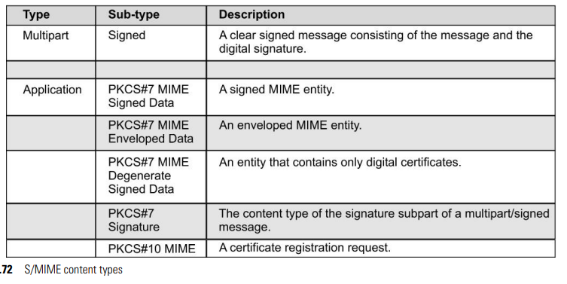
S/MIME Message Content Types

Slide 32
S/MIME Messages – Enveloped Data
An application/pkcs7-mime subtype is used for one of four categories of S/MIME processing, each with a unique s/mime-type parameter
The steps for preparing an envelopedData MIME entity are:
1. Generate a pseudorandom session key for a particular symmetric encryption algorithm (RC2/40 or triple DES).
2. For each recipient, encrypt the session key with the recipient’s public RSA key.
3. For each recipient, prepare a block known as RecipientInfo that contains an identifier of the recipient’s public-key certificate, an identifier of the algorithm used to encrypt the session key, and the encrypted session key.
4. Encrypt the message content with the session key.

Slide 33
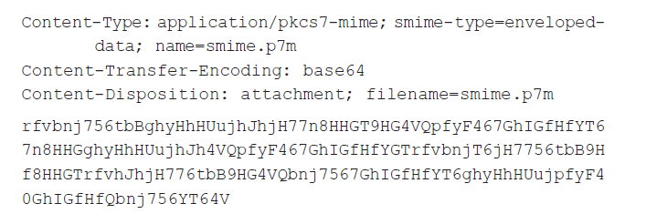
S/MIME Messages – Enveloped Data

Slide 34
S/MIME Messages – Signed Data
1. Select a message digest algorithm (SHA or MD5).
2. Compute the message digest (hash function) of the content to be signed.
3. Encrypt the message digest with the signer’s private key.
4. Prepare a block known as SignerInfo that contains the signer’s public-key certificate, an identifier of the message digest algorithm, an identifier of the algorithm used to encrypt the message digest, and the encrypted message digest

Slide 35
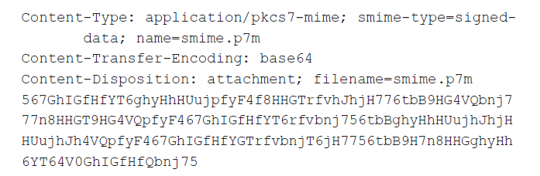
S/MIME Messages – Signed Data
To recover the signed message and verify the signature, the recipient first strips off the base64 encoding.
Then the signer’s public key is used to decrypt the message digest.
The recipient independently computes the message digest and compares it to the decrypted message digest to verify the signature.

Slide 36
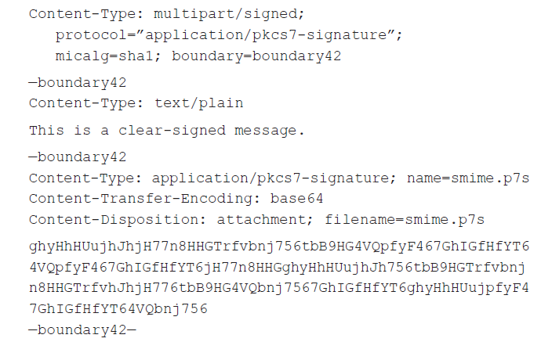
S/MIME Messages – Clear Signing

Slide 37
S/MIME Certificate Processing
S/MIME managers and/or users must configure each client with a list of trusted keys and with certificate revocation lists.
User Agent Role An S/MIME user has several key management functions to perform.
Key generation
Registration
Certificate storage and retrieval

Slide 38
Enhanced Security Services
Signed receipts
Security labels
Secure mailing lists
Signing certificates

